Slide 1

SATHYABAMA
INSTITUTE OF SCIENCE AND TECHNOLOGY
(DEEMED TO BE UNIVERSITY)
CATEGORY-I UNIVERSITY BY UGC
Accredited “A++” by NAAC | Approved by AICTE
FOOT STEP POWER GENERATION
Team Members :
Mandla Ganesh Kumar – 43611259
M Vaibhav Varshith Reddy - 43611255
K Sudheer – 43611244
Krishika Soni – 43611236
Sanjana Kumari - 43611233
Harsh Pandey - 43611274
Mentor :
N.Jeenath Shafana , M.E,(Ph.D)
Assistant Proffesor
Department of CSE

Slide 2
AGENDA
Abstract
Objective
Empathize
Problem Definition
Ideation
Introduction
Existing model
Proposed Model
Feasibility study
Components/Hardware requirement & Assembling
Software requirements
Prototype and Implementation
Testing
Feedback
Applications
References

Slide 3
ABSTRACT
Footstep power generation through mechanical stress conversion is a sustainable method for harvesting energy. This system works by converting the mechanical stress applied to a surface into electrical energy using piezoelectric or electromagnetic components. When stress is applied—such as pressure from walking or machinery—it activates energy conversion elements embedded in the surface. The generated power can be used for low-energy applications or stored for later use.

Slide 4
OBJECTIVE
The objective of this project is to design a system that converts mechanical stress, generated through footsteps, into electrical energy. The system will utilize piezoelectric or mechanical transducers to efficiently transform applied pressure into usable power. It aims to provide a renewable and eco-friendly energy source suitable for powering low-energy devices. The setup is intended to be compact, durable, and capable of operating in high-footfall areas. This project promotes sustainable energy harvesting by capturing energy from everyday mechanical stress.

Slide 5
EMPATHIZE
Developing a footstep power generation system requires a clear understanding of user needs in areas like schools, offices, shopping centers, and walkways where foot traffic is consistent. Users expect the system to be safe, comfortable, and non-intrusive. The main challenge is designing a durable and efficient setup that can convert mechanical stress into electricity without needing frequent maintenance. It must also be cost-effective and generate usable energy from minimal pressure. Meeting these needs ensures the system is practical and user-friendly.

Slide 6
PROBLEM DEFINITION
A large amount of mechanical stress from footsteps in public areas goes unused. Footstep power generation addresses this by converting that stress into electrical energy using piezoelectric or mechanical systems. The challenge is to create a system that is efficient, durable, cost-effective, and user-friendly. This project aims to develop a solution that harvests energy from everyday activity to support sustainable power generation.

Slide 7
IDEATION
To convert mechanical stress from footsteps into electrical energy, the idea focuses on embedding piezoelectric or mechanical components beneath floor surfaces. These components generate electricity when pressure is applied. The design considers modular floor tiles for easy installation and maintenance. Energy storage options like rechargeable batteries or capacitors are included to store the generated power. The system aims to be cost-effective, durable, and suitable for high-footfall areas.

Slide 8
INTRODUCTION
Footstep power generation is an innovative method of converting mechanical stress from footsteps into electrical energy. Using piezoelectric or mechanical systems, this technology captures pressure applied to the floor and transforms it into usable power. It offers a sustainable and eco-friendly solution for low-energy applications in high-footfall areas.

Slide 9
EXISTING MODEL
Existing Model: Kinetic Energy-Based Power Generation
One widely used model for generating electricity from kinetic energy involves the use of electromagnetic induction, commonly seen in systems like bicycle dynamos and hand-crank generators. In this setup, kinetic energy from motion—such as pedaling, walking, or rotating a handle—is used to rotate a magnet within a coil, inducing an electric current.

Slide 10
PROPOSED MODEL
Piezoelectric-Based Model:
This is one of the most widely used models for footstep power
generation. It relies on piezoelectric materials, which generate
an electric charge when subjected to mechanical stress or
pressure. These materials are installed beneath floor tiles, so
when someone steps on the tile, the applied force produces a
small voltage. To increase energy output, multiple tiles
are connected in an array.

Slide 11
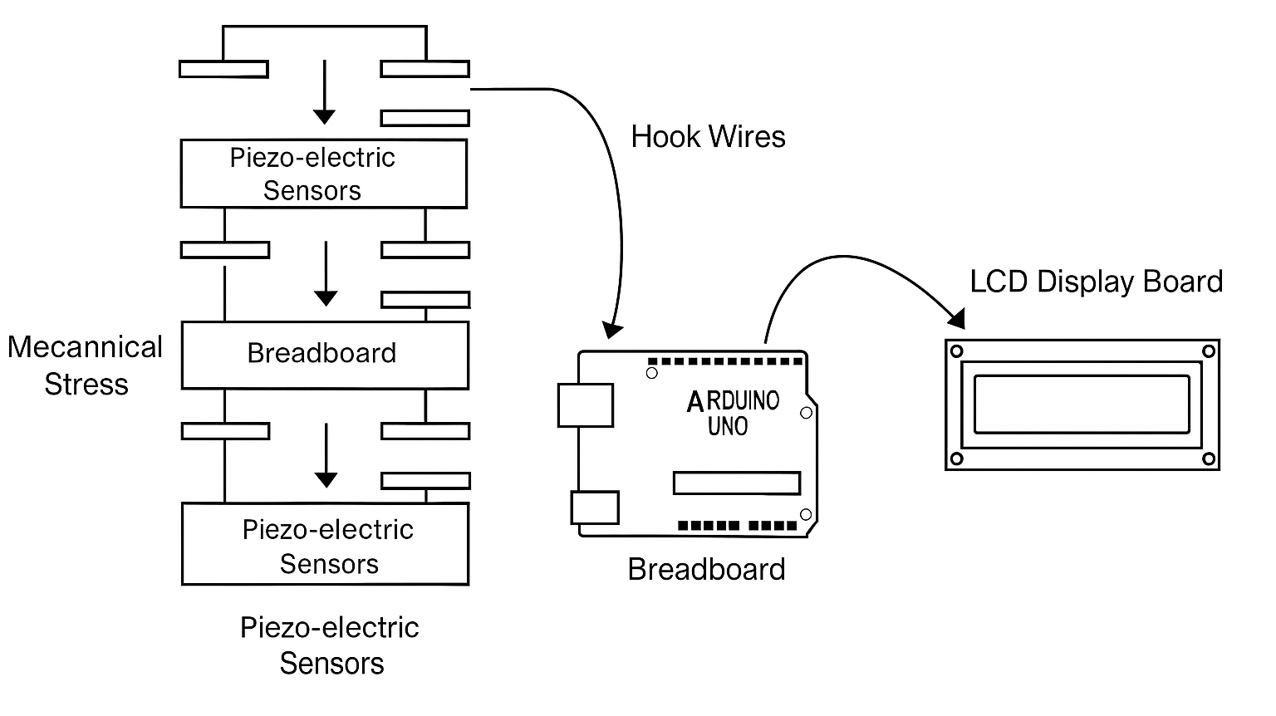
BLOCK DIAGRAM

Slide 12
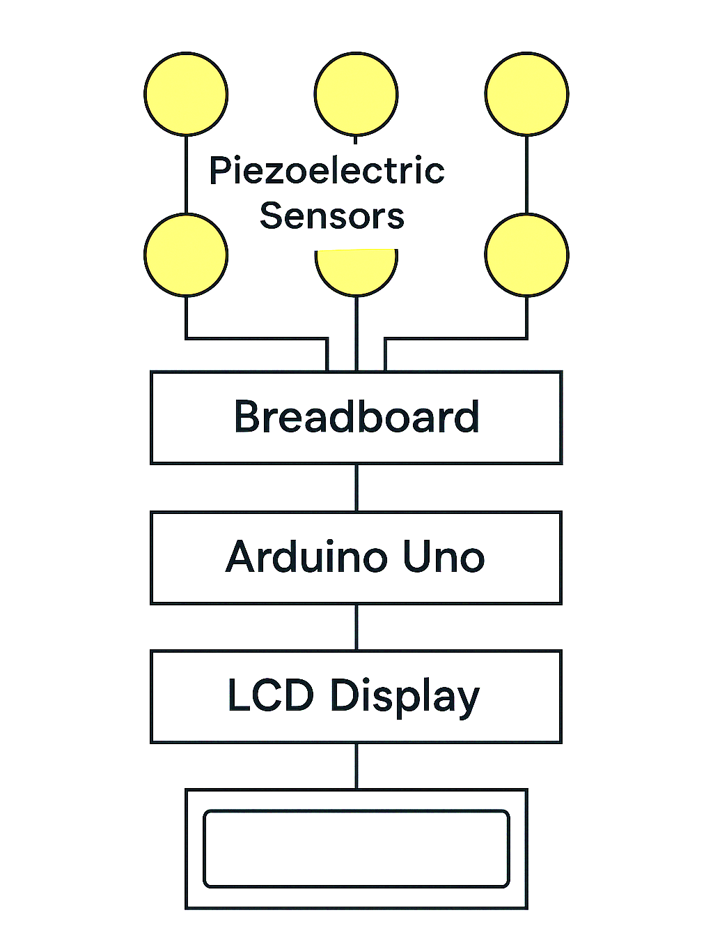
ARCHITECTURE DIAGRAM

Slide 13
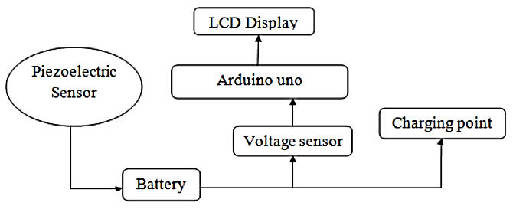
FLOW DIAGRAM

Slide 14
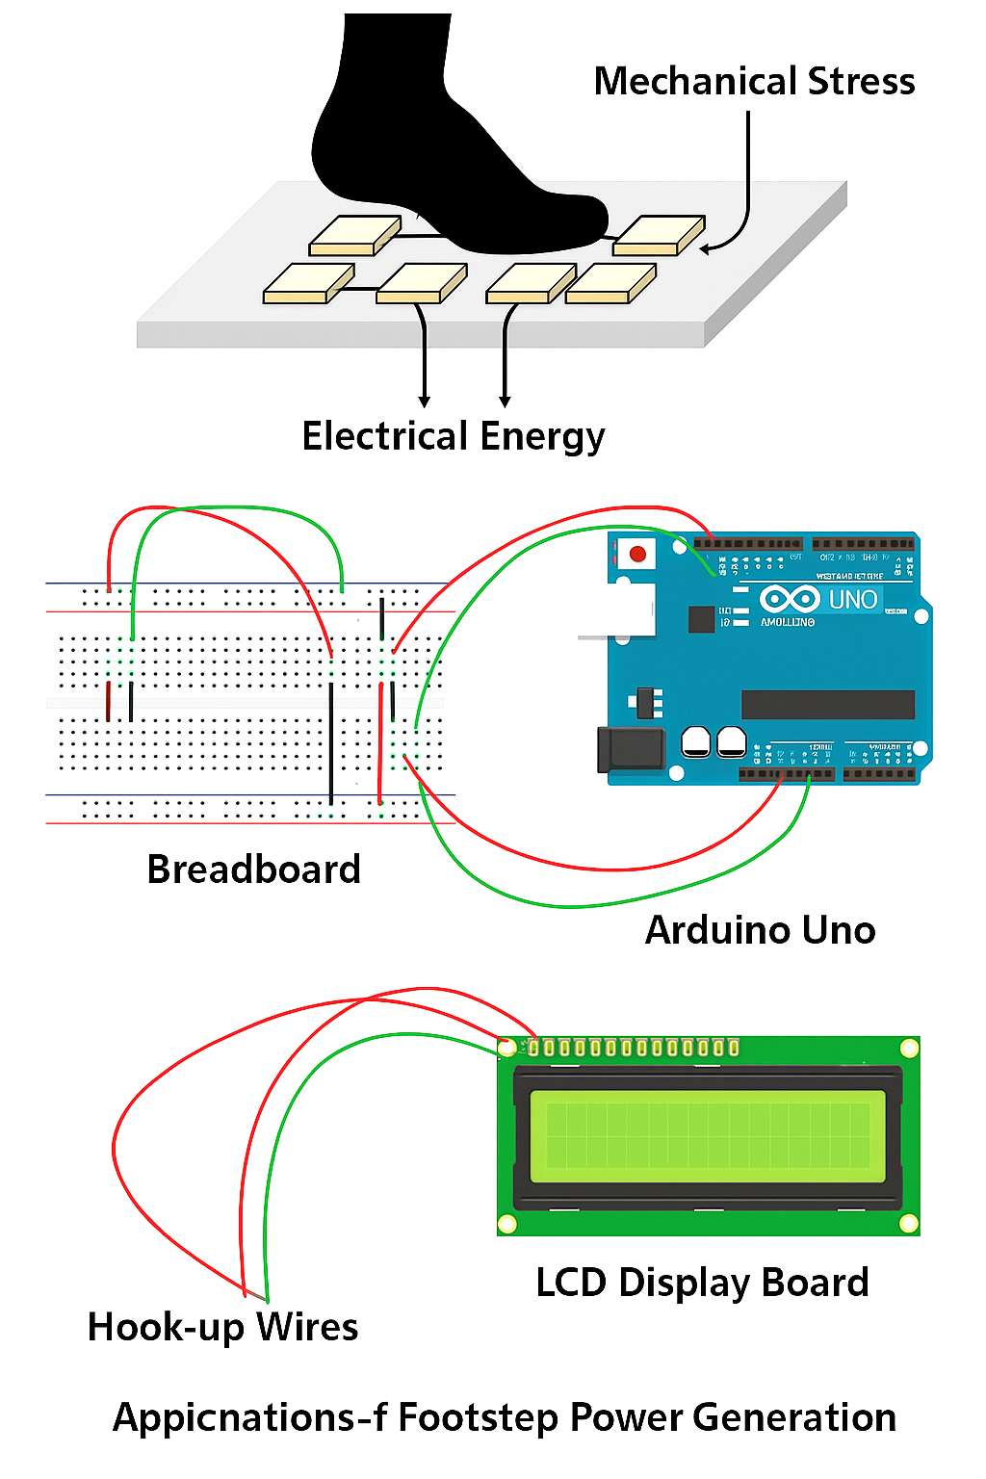
DESIGN DIAGRAM

Slide 15
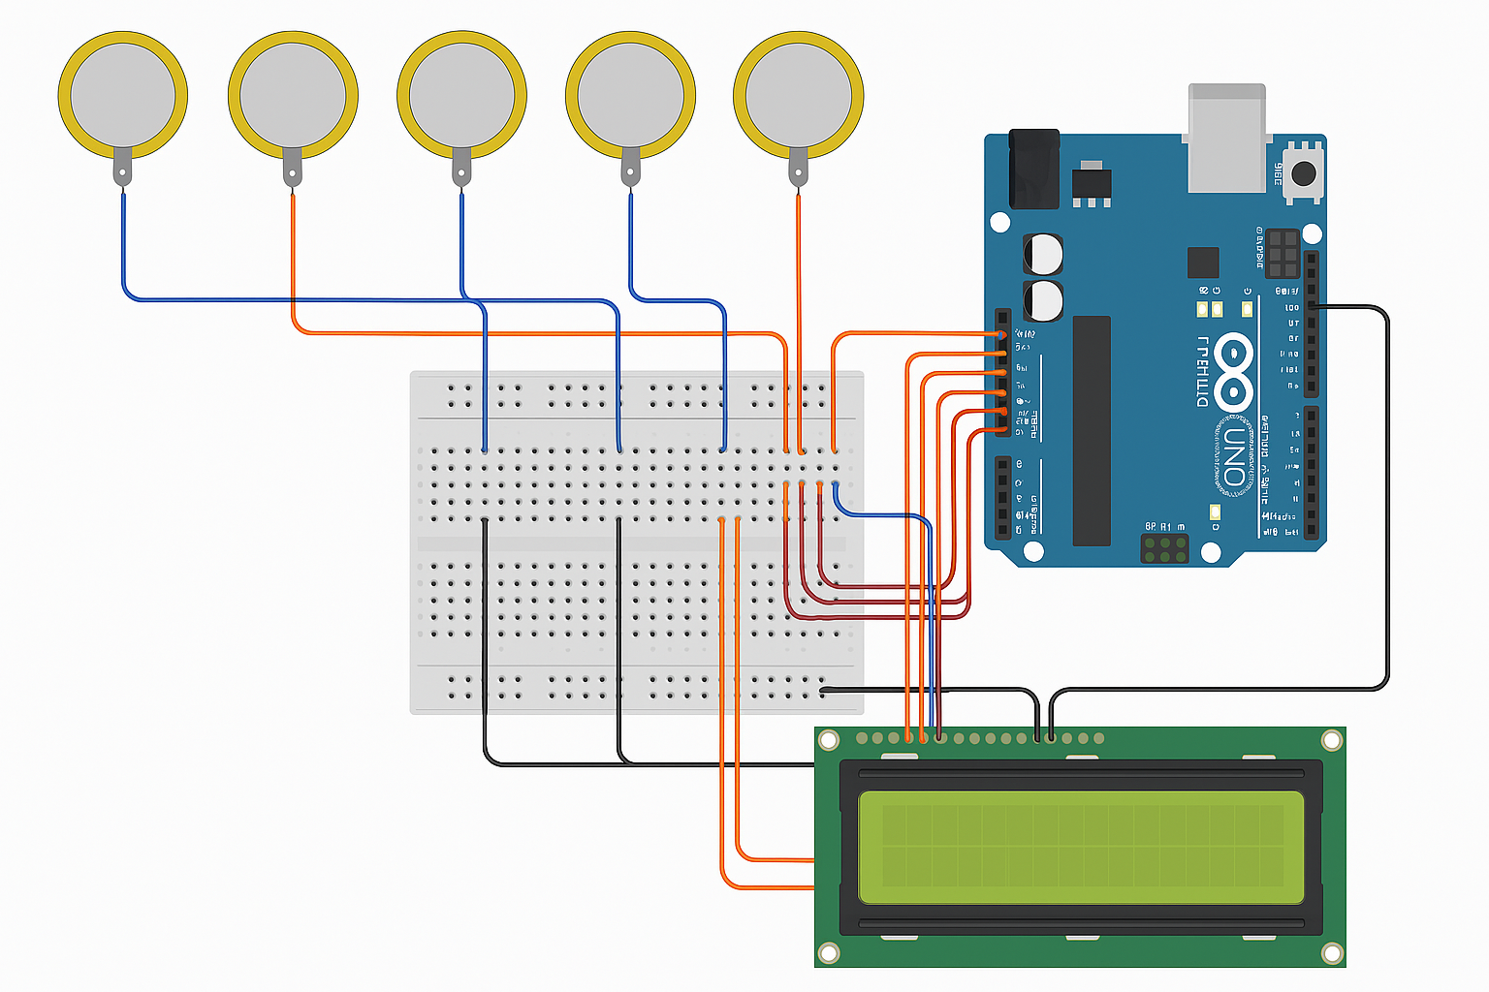
CIRCUIT DIAGRAM
STEPS : 18
VOLT : 0.00V

Slide 16
FEASIBILITY STUDY
The footstep power generation system is an innovative solution designed to convert mechanical energy generated from human footfalls into electrical energy using piezoelectric or electromagnetic mechanisms .The primary objective of this study is to evaluate whether such a system can be technically, operationally, economically, legally, and environmentally viable for deployment in public, commercial, or institutional spaces.

Slide 17
TECHNICAL FEASIBILITY
Aspect | Description
Technology | Readily available piezoelectric tiles, electromagnetic coils, and energy storage circuits.
Output Power | ~2–20 mW per footstep (piezo), 10–50 mW (electromagnetic with gear/mass design).
Scalability | Suitable for high-footfall areas: train stations, malls, stadiums, sidewalks.
Energy Storage | Battery, capacitor, or supercapacitor for accumulating generated energy.
Integration | Can be installed under floor tiles or embedded in pavement surfaces.

Slide 18
ECONOMICAL FEASIBILITY
Parameter | Estimate / Consideration
Initial Cost | Medium to high depending on materials (Rs.2500-3000)
Maintanance | Low; minimal moving parts (exceptelectromagnetic designs).
ROI | Long-term; dependent on foot traffic and energy use (e.g., LED lighting, sensors).
Used Parts | Arduino UNO , Beard board, Six piezo-electric sensors, LCD display board

Slide 19
MARKET FEASIBILITY
Segment | Description
Smart Cities | Integration into sidewalks, bus stops, and metro stations for powering lights or displays.
Educational Institutions | As a learning tool or for sustainable campus energy solutions.
Shopping Malls & Airports | For powering interactive displays or creating awareness of green energy.
Sports Arenas & Parks | High footfall areas perfect for energy harvesting.
Railway/Metro Stations | To power sensors, ticket counters, or emergency lighting.

Slide 20
OPERATIONAL FEASIBILITY
Operational feasibility evaluates whether the system can be practically implemented and sustained in real-world environments.
1. Installation Requirements :
Can be embedded in pavements, stairs, floors, or tiles.
Requires basic civil support for embedding piezoelectric/electromechanical units.
Power output components (e.g., energy harvesting circuits, batteries) must be safely enclosed.
2. Ease of Use :
Passive system – works automatically when people walk on it.
Requires no user input or interaction, making it highly accessible.
3. Maintenance and Durability :
Low-maintenance if designed with robust materials.
Piezoelectric systems are solid-state, hence minimal mechanical wear.
Periodic inspection for wiring, power storage units, and external wear is necessary.
4. Scalability :
Can be modularly scaled from a few tiles to entire corridors or walkways.
Ideal for pilot projects that can later expand based on performance.

Slide 21
LEGAL FEASIBILITY
Legal feasibility examines compliance with regulations, standards, and potential liabilities.
1. Zoning and Permits :
Installation in public places (roads, stations, parks) requires permits from municipal authorities.
May need approval from urban development departments or smart city initiatives.
2. Electrical Safety Standards :
System must comply with local electrical codes and safety standards (e.g., IEC, IEEE, or national equivalents).
Proper insulation, circuit protection, and weatherproofing are mandatory.
3. Liability and Insurance :
Public installations must consider trip hazards, electrical safety, and injury liability.
Required: public liability insurance for installations in areas with heavy pedestrian traffic.
4. Environmental Regulations :
Ensure materials used (e.g., piezo ceramics or batteries) do not pose an environmental hazard.
Consider recyclability and end-of-life disposal compliance.

Slide 22
COMPONENTS/HARDWARE REQUIREMENTS & ASSEMBLING
Arduino Uno
12V Battery
Voltage Sensor
16*2 LDC Display
Piezoelectric Sensor
Charging Point

Slide 23
STANDARD SPECIFICATION(BIS)
Conversion Principle: Piezoelectric effect – mechanical stress generates electric charge.
Technology Type: Solid-state piezoelectric transducer (PZT or quartz-based).
Material Used: High-impact polymer or metal casing with embedded piezoelectric layers.
Power Output per Step: 2–20 milliwatts (depends on pressure and transducer efficiency).
Output Voltage Range: 5V – 15V (AC or DC via rectifier circuit).
Output Current Range: 5 mA – 50 mA per unit under optimal stress.
Storage System: Rechargeable Li-ion battery or supercapacitor (1.2V to 12V rated).
Energy Conditioning Circuit: Rectifier, voltage regulator (buck-boost), capacitor bank.
Efficiency: ~30–60% (depending on piezo material and circuit optimization).
Application Areas: Railway platforms, footbridges, shopping malls, school corridors, bus stops, event spaces.
Installation Type: Flush floor mount or modular tile insert with bolted/snap-fit mounting.
Output Use Cases: LED lighting, motion sensors, advertisement displays, mobile charging, data loggers.

Slide 24
SOFTWARE REQUIREMENTS
Arduino IDE
Embedded-C

Slide 25
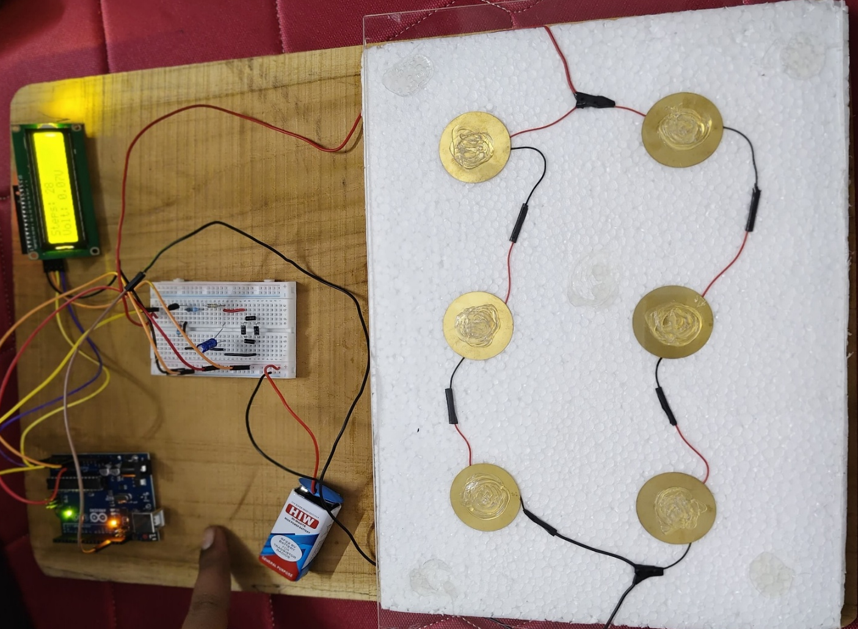
PROTOTYPE AND IMPLEMENTATION
We connected 6 piezo-electric sensors and Arduino UNO to Beard Board and LCD display board
via hook wires

Slide 26
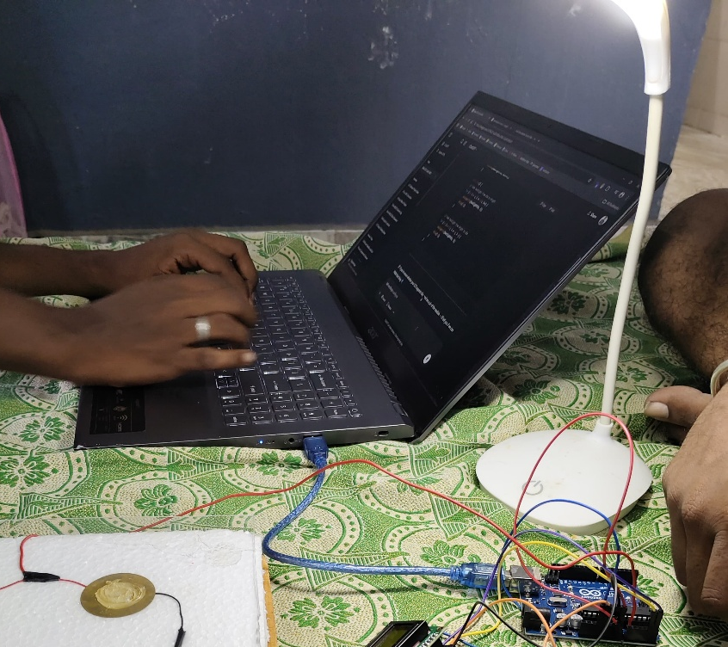
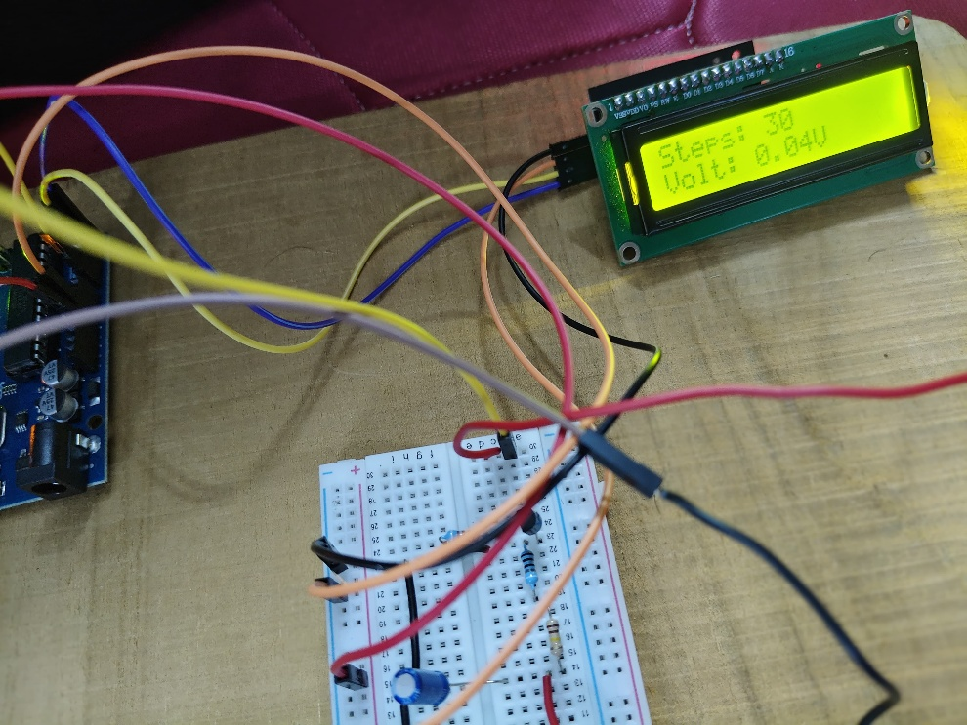
TESTING
Testing Arduino code
Successful Tested Result

Slide 27
FEEDBACK
The footstep power generation system is a highly innovative and forward-thinking concept that creatively transforms mechanical stress from human movement into usable electrical energy. This solution not only addresses energy challenges in urban spaces but also promotes public engagement with clean technology in a visible and interactive way. Its passive operation, minimal maintenance, and potential for modular scalability make it a promising addition to future smart cities. With further refinement in efficiency, energy storage

Slide 28
APPLICATIONS
Street and Pathway Lighting Powering LED lights along sidewalks, parks, or pedestrian crossings using energy from foot traffic.
Railway and Bus Stations Generating energy to operate digital information boards, lighting, or surveillance cameras in crowded transit areas.
Shopping Malls and Airports Powering advertising displays, ambient lighting, or floor indicators in high-footfall zones.
School and University Campuses Demonstrating renewable energy concepts while powering hallway lights or lab equipment.
Public Parks and Smart Benches Charging small devices like mobile phones or sensors on benches powered by footsteps.
Footbridges and Stairways Capturing energy from vertical movement to power safety lights or emergency signals.
Sports Arenas and Stadiums Harvesting energy during events to power crowd sensors or decorative lighting.

Slide 29
REFERENCES
Patil, S., & Patil, R. (2018). Electricity Generation Using Foot Step. International Journal of Engineering Research & Technology (IJERT), 7(5), 1–4. https://www.ijert.org/electricity-generation-using-foot-step
Bodkhe, U. R., & Shaikh, M. I. (2015). Foot Step Power Generation System Using Piezoelectric Sensor. International Journal of Engineering Trends and Technology (IJETT), 25(4), 224–229. https://doi.org/10.14445/22315381/IJETT-V25P243
Lakshmi, K., & Swetha, K. (2017). Power Generation from Footstep Using Piezoelectric Sensors. International Journal of Mechanical Engineering and Technology (IJMET), 8(5), 378–384. http://www.iaeme.com/IJMET/issues.asp?JType=IJMET&VType=8&IType=5
Piezoelectric Energy Harvesting: Review and Applications Sodano, H. A., Inman, D. J., & Park, G. (2004). Shock and Vibration Digest, 36(6), 197–206. https://doi.org/10.1177/058310240403600204

Slide 30
THANK YOU
We thank God, Our Department, Mentor, Panel Members, Supportive Professors and all Technical and non Technical staff who helped us in our Product Development.

